Slide 1


CREDGO
"Building a Better World, One Hour at a Time."
PRESENTED BY:
B.Ramya (229301416)
Nupur Agarwal(229301186)

Slide 2


03 | Overview
04 | Goals and company vision
05 | Target Audience
06 | Frontend (User Interface & Experience)
07 | Backend (Server & Database Management)
08 | Code
09 | Software Model Selected
10 | Software testing
Agenda

Slide 3

01
CredGo is a web-based platform where users volunteer their time, earn time credits ("Creds"), and exchange them for services offered by other users — creating a community-driven ecosystem based on time, not money.
03/10
Overview
CredGo promotes volunteerism, builds stronger communities, and recognizes time as valuable currency, making service accessible, rewarding, and sustainable for everyone.
Volunteers list their skills, contribute hours to help others, earn Creds, and use those Creds to request services they need — all tracked securely through Firebase Authentication and Firestore.
02
www.reallygreatsite.com

Slide 4


04/10
Objectives and Goals
Goal # 1
Goal # 2
Goal # 3
Empower individuals to exchange time and skills, creating a self-sustaining community of service.
Recognize and reward volunteer efforts by turning time into a valuable, tradable asset.
Foster a culture of kindness, collaboration, and social impact through time banking.

Slide 5



05/10
Target Audience
Students and Young Professionals
Non-Profits, NGOs, and Community Groups
Skill-based Volunteers and Freelancers

Slide 6
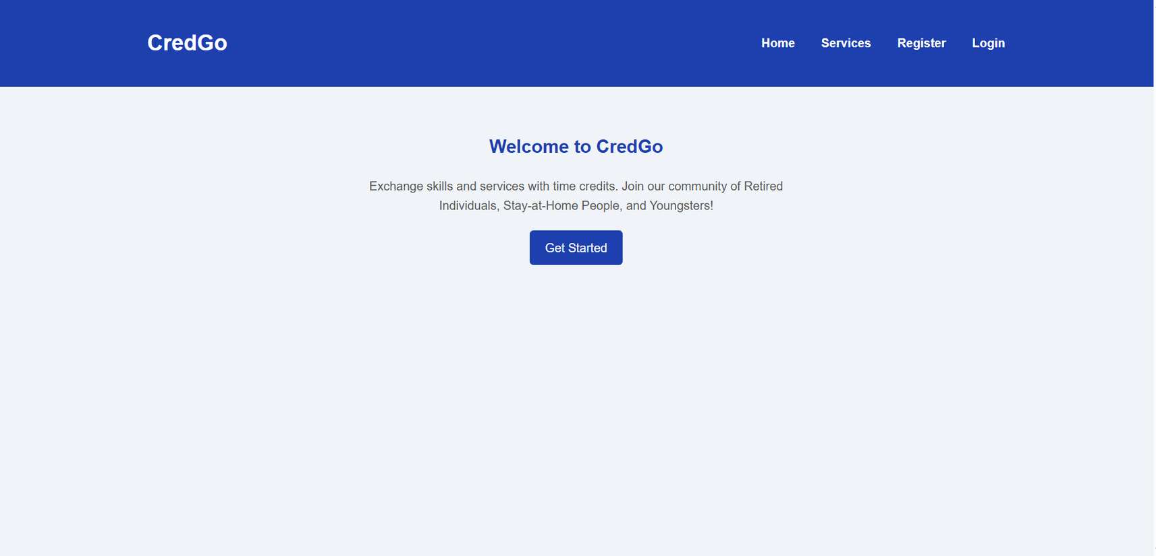
Frontend (User Interface & Experience)
06/10
Technologies:
HTML5, CSS3, JavaScript (or optionally React.js for scaling later)
Tailwind CSS (for faster, responsive, modern design)
Animations (CSS Animations / GSAP for smooth transitions)
Responsive Design (mobile and desktop friendly)
Main Features:
User-friendly signup/login forms
Dashboard to track Creds earned and spent
Service listing and browsing interface
Request service / Offer service forms
Leaderboard and badges display
Notification and updates section

Slide 7
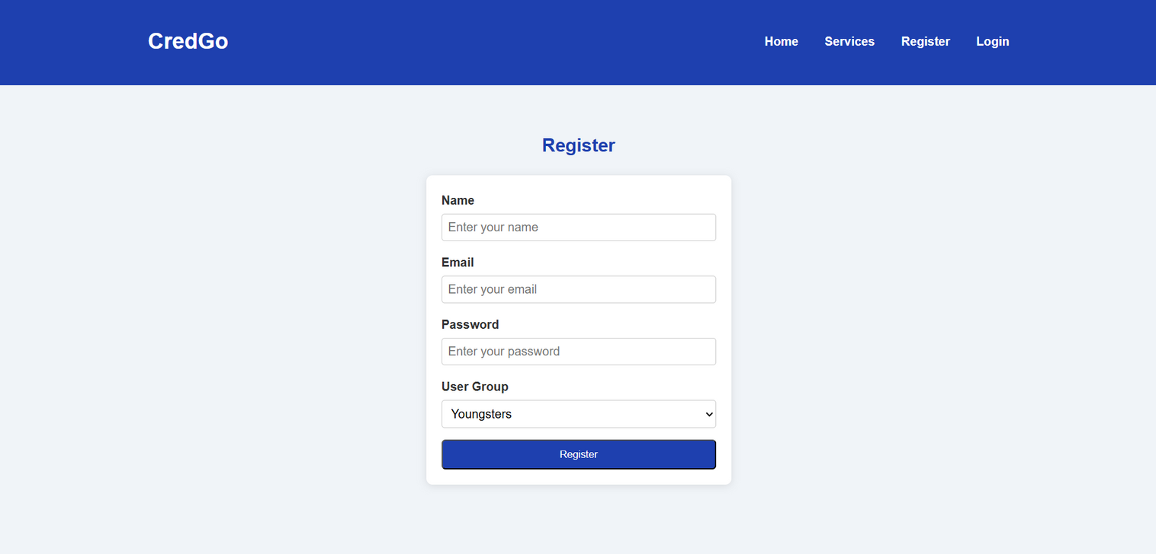
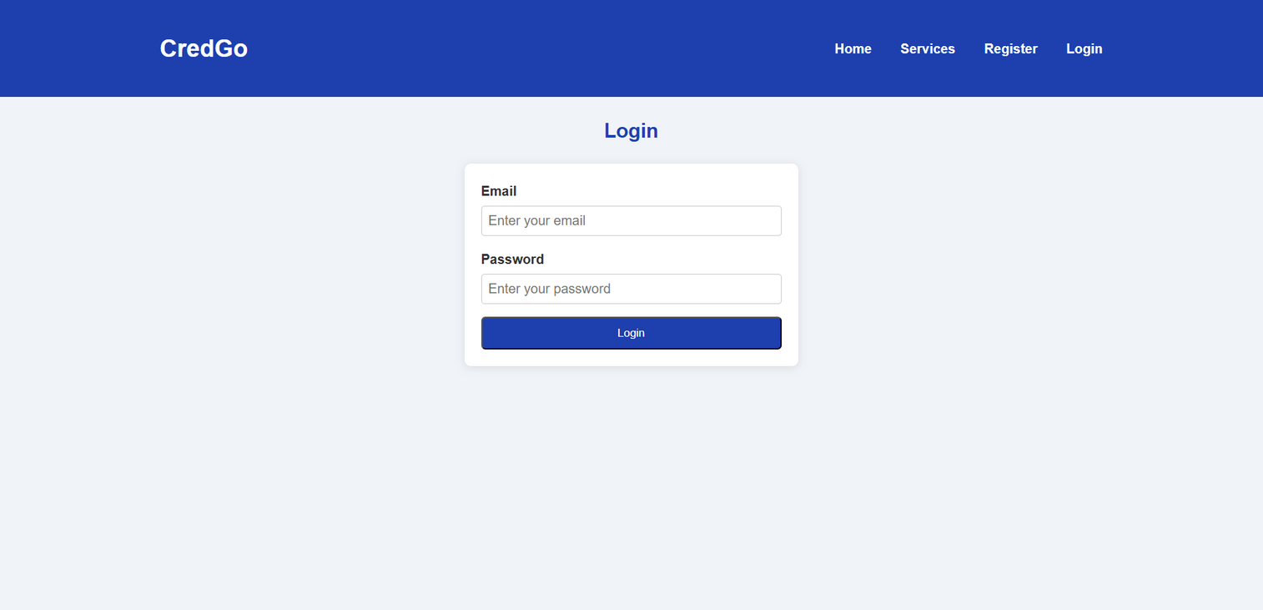

Slide 8
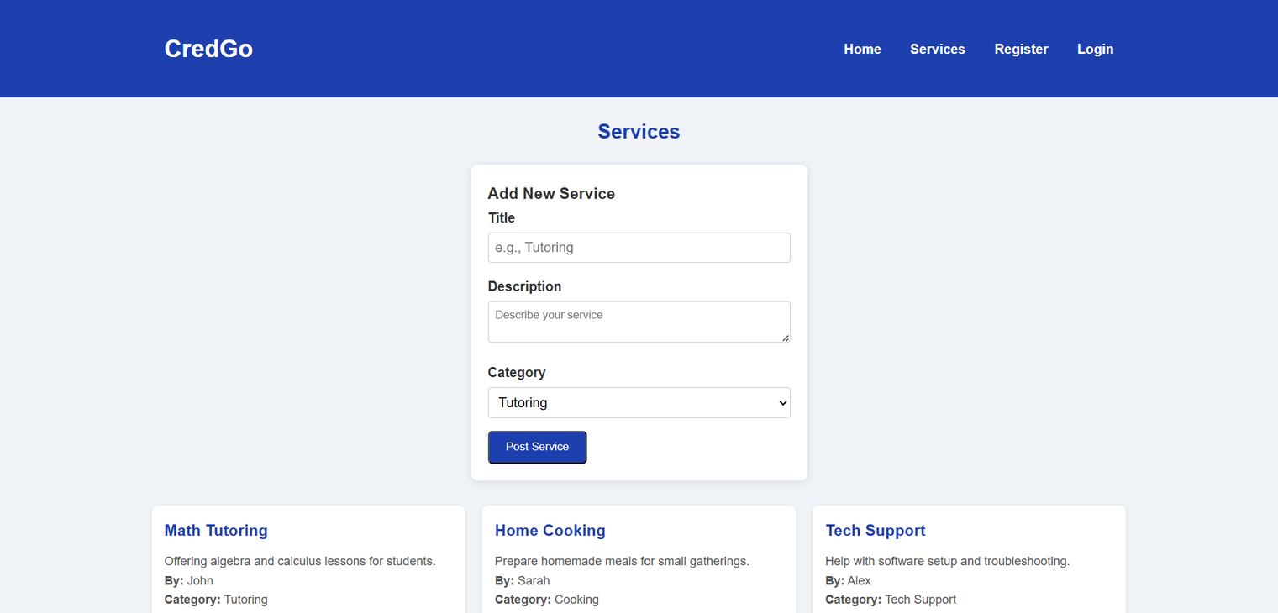

Slide 9
Backend (Server & Database Management)
07/10
Technologies:
Firebase Authentication: Secure signup/login using email/password (or Google login)
Cloud Firestore Database: Real-time storage of user profiles, services offered/requested, and Cred transactions
Firebase Hosting: Hosting the web application for fast, global access
Cloud Functions (optional, future-ready): For automating tasks like sending notifications or matching services
Main Functionalities:
Secure authentication and authorization of users
Storing user skills, services, and time credits
Tracking and updating Cred transactions after every service exchange
Managing real-time data updates for service availability

Slide 10
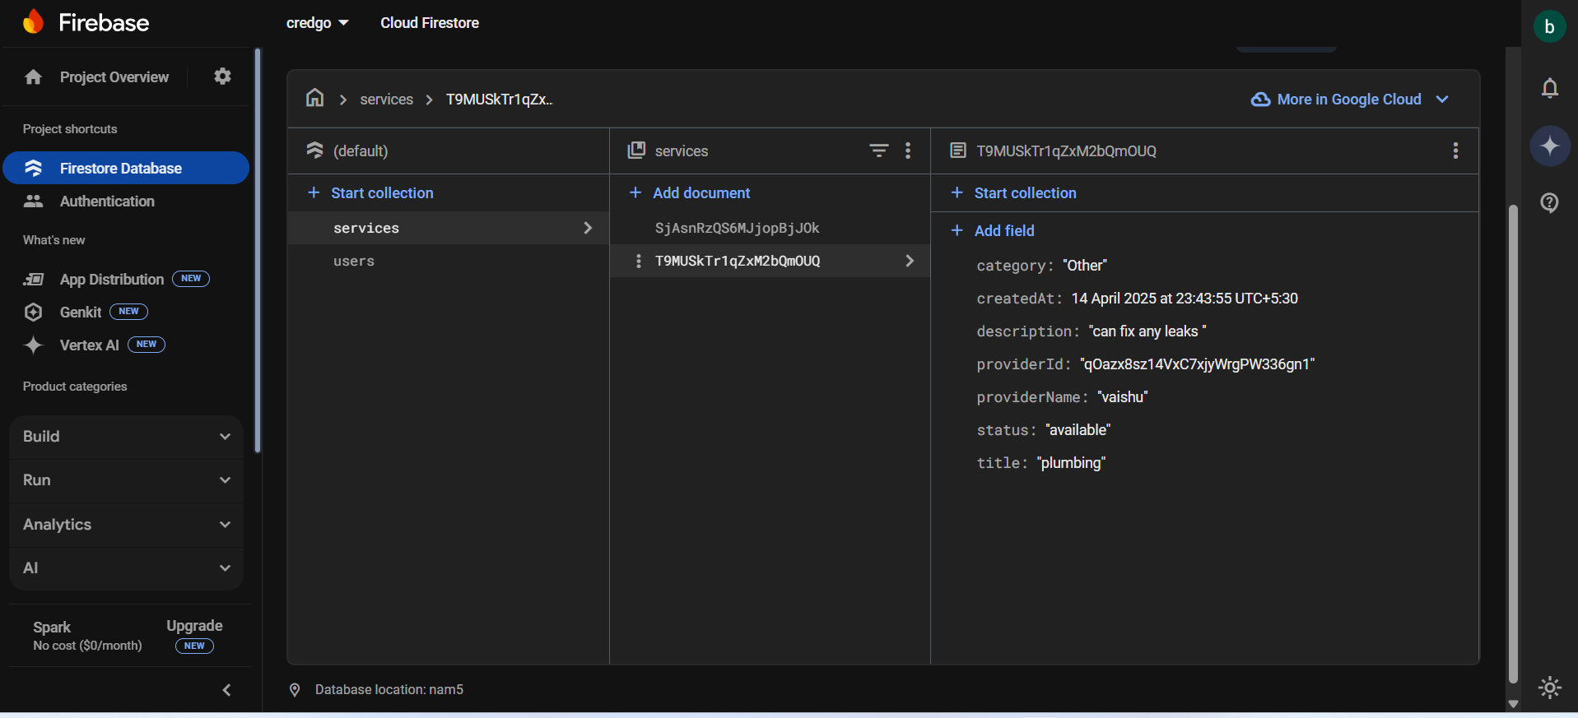

Slide 11
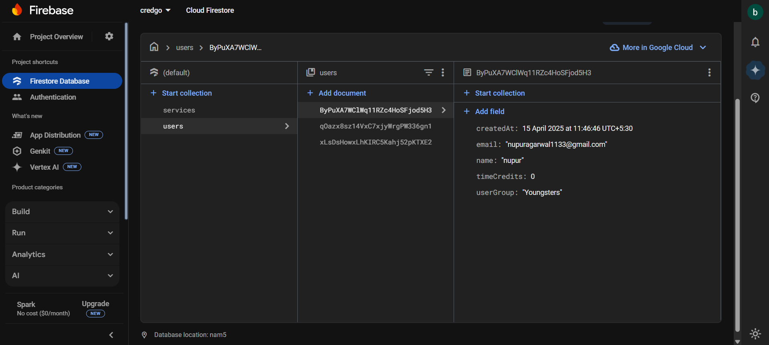

Slide 12
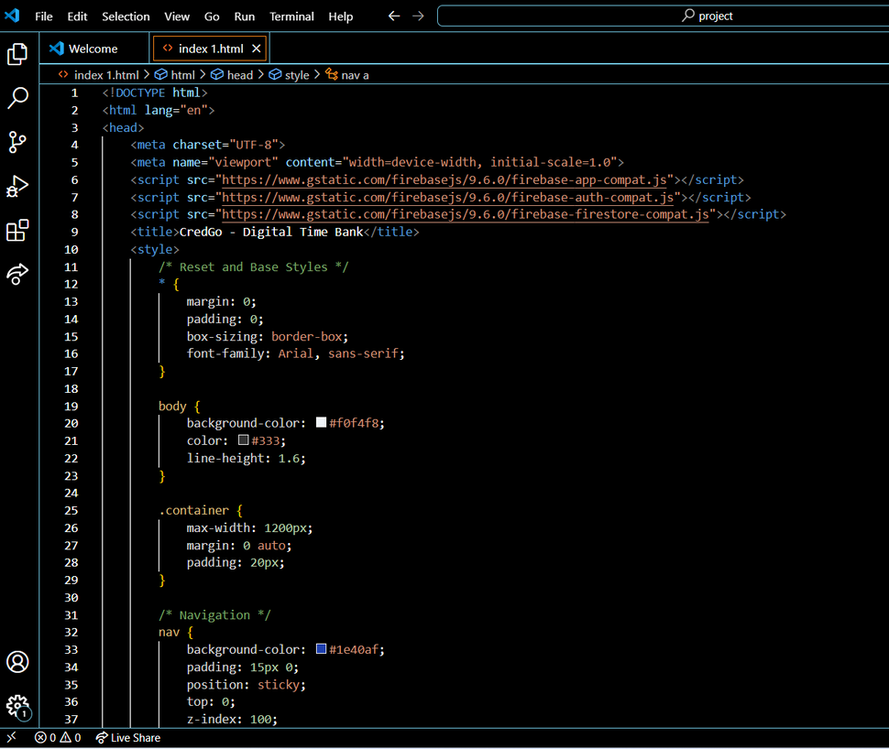
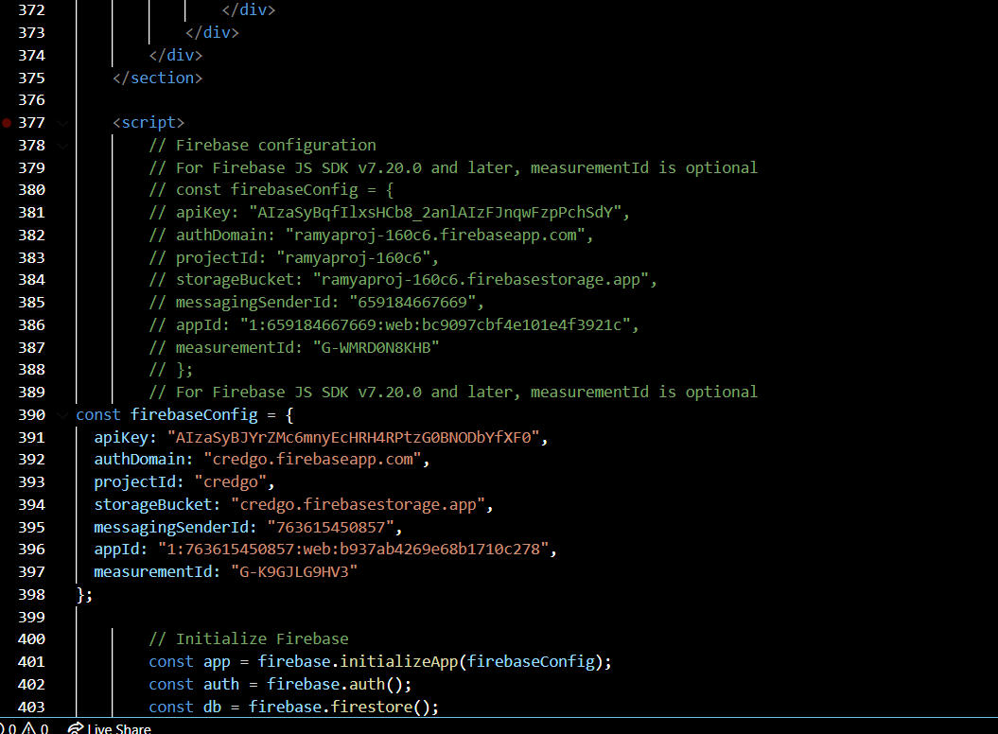
Code
08/10

Slide 13

09/10
Software Model Selected
Model Selected: Agile Development Model
Reason for Selection:
Focuses on flexibility, continuous improvement, and quick delivery.
Development is done in small, iterative sprints allowing fast feedback and updates.
Prioritizes user needs and changing requirements, perfect for a growing platform like CredGo.

Slide 14
Software Testing
10/10
Content:
Testing Approaches Followed:
Sprint-wise Testing:
After each sprint, features like login, service posting, Cred calculation were tested.
Unit Testing:
Tested individual modules separately (example: only login or only Cred addition).
Integration Testing:
Ensured smooth interaction between modules (example: after earning Creds, user can request services).
User Acceptance Testing (UAT):
End-users tested the system to check usability and performance.
Tools Used:
Manual Testing
Firebase Console for backend testing
Browser Developer Tools for frontend testing

Slide 15
Thank you

